Slide 1

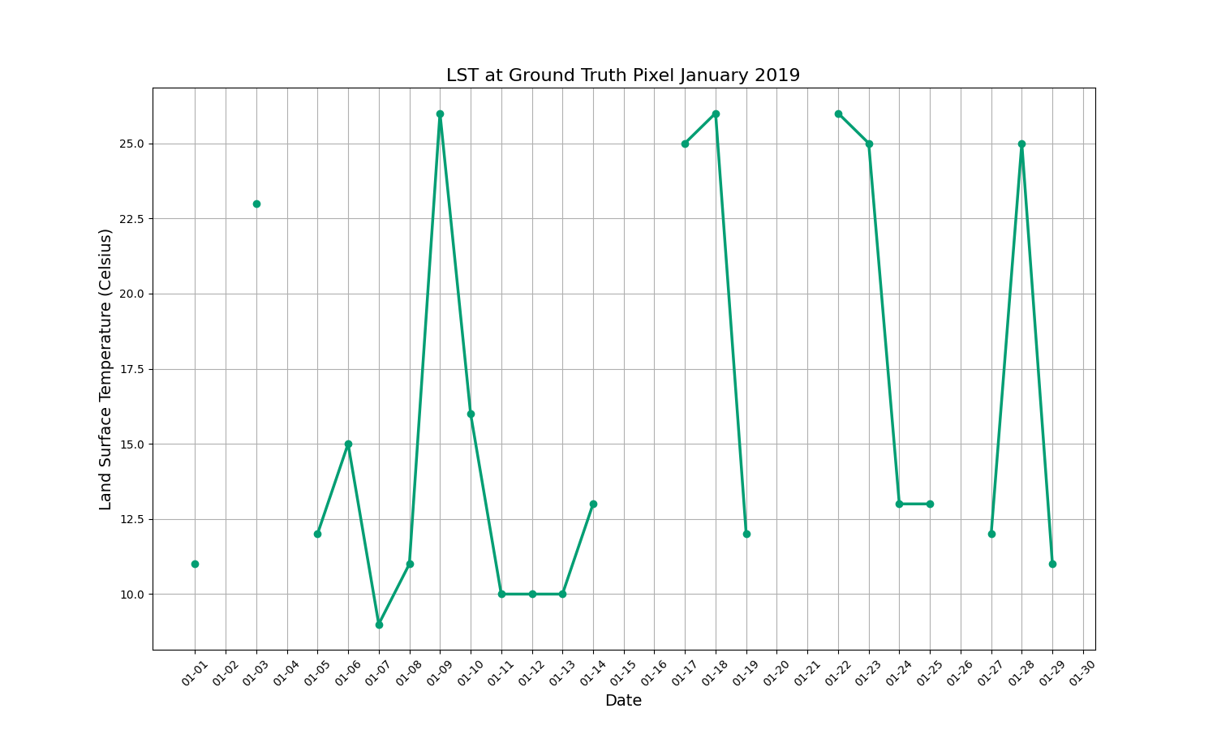
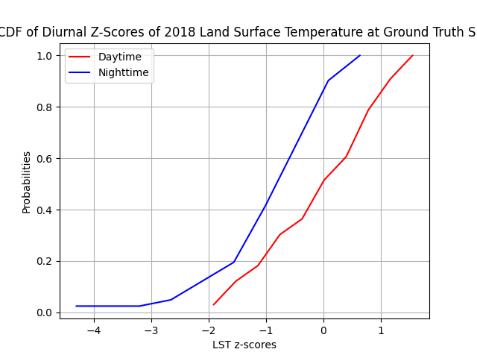
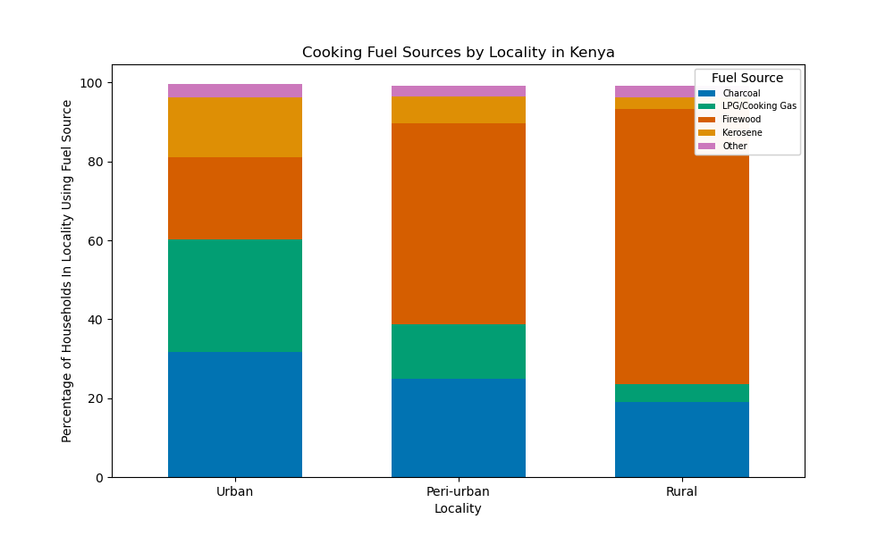
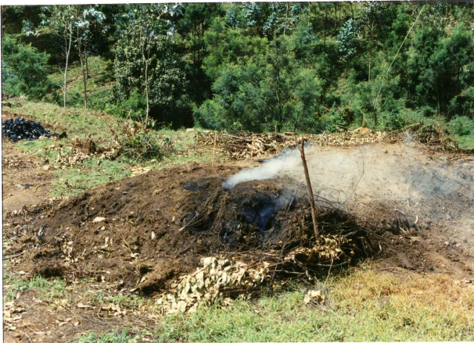
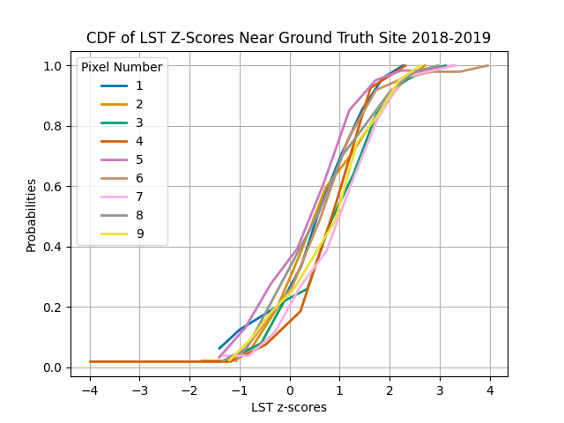
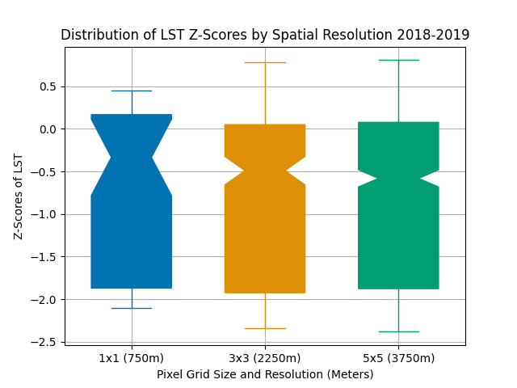
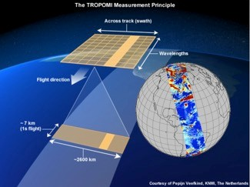
Locating Charcoal Production Sites with Remotely Sensed Data in East Africa
Skyler Gipson, Jay Taneja, Aggrey Muhebwa, Bob Muhwezi
Department of Electrical and Computer Engineering, UMass Amherst
Introduction
Results
Charcoal is a major fuel source in urban Africa, and must be made more sustainable during the energy transition.
Production bans are largely ineffective as sites are difficult to locate and little is known about the supply chain.
A more effective approach is needed to document sites and establish beneficial regulations on production.
LST data contains many temporal inconsistencies, making it difficult to discern periods of elevation.
Diurnal variations in LST mask trends in daytime and nighttime LST variations.
Kenya Cooking Fuel Source Mix by Locality
Charcoal Production Site—Earth Mound Kiln
Cumulative Distribution Function of LST Z-Scores, 2018 January-June Mean, July-December Z-Scores
We predict that outliers in spatiotemporal patterns at ground truth sites can be used to locate unconfirmed production sites.
Kenya LST Time Series, January 2019
Minimal variation occurs between nearby pixels and most pixels have positive readings for this period.
Aggregated LST data could indicate that nearby pixels have the same LST trend at the same times.
Research Questions and Methods
To what extent can new metrics in advancing satellite technology be used to identify high-resolution patterns on Earth’s surface?
Land surface temperature dataset: 750m spatial, <daily temporal resolution, from the Suomi NPP VIIRS Instrument
CO and NO₂ pollutant data: 25km (interpolated to 1km) spatial, daily temporal resolution from TROPOMI instrument onboard the Copernicus Sentinel-5 Precursor Satellite.
CDF of Pollutant Concentration Z-Scores for Aggregated Ground Truth Region, 2019 January-June Mean, July-December Z-Scores
Distribution of LST Z-Scores over Aggregated Pixels, 2018 Mean, 2019 Z-Score
Conclusions
In order to approach finding miniscule production sites using remotely sensed data, large datasets are needed to account for spatial and temporal gaps and find outliers within regular temporal trends, such as diurnal and seasonal variation. Aggregating mid-resolution data over larger areas accounts for gaps in data while still revealing outliers.
Developing a method to analyze these conditions and find production sites could aid in furthering knowledge on the charcoal production chain and lend a path for adapting current government regulations and methods as needed.
I would like to thank the NSF for the Grant 2243853 allowing me to pursue this research.
Can land surface temperature (LST) and pollution concentrations be used to indicate production sites?
How can these be combined to identify outliers in standard conditions at confirmed production locations?

